Slide 1
Anomaly Detection
Vinay L.
Dan A.
Rakim Z.

Slide 2
Introduction
Detecting anomalies in power grid data through the use of semi-supervised techniques
Three main components:
Principal Component Analysis
HMM (training and testing)
Anomaly detection (log-lik, moving average)
Technical essay
to explore the capabilities and benefits of using reinforcement learning for anomaly detection

Slide 3
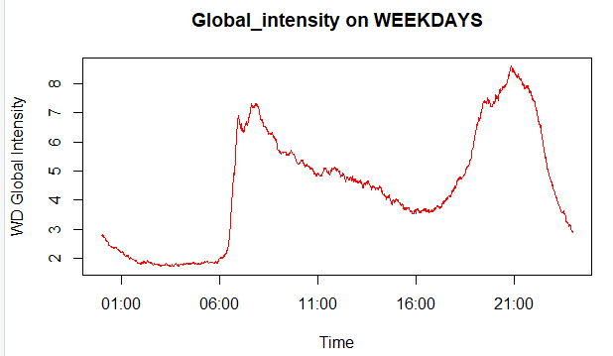
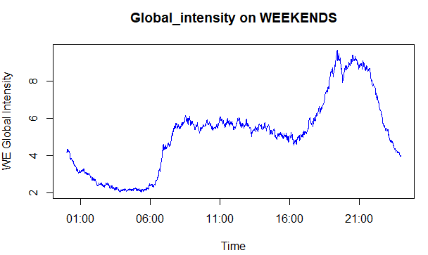
Choosing Suitable Variables
Determining time windows that best represent the
data
Weekdays and weekends had different energy
consumption patterns
All techniques were applied separately to the
weekend and weekday datasets

Slide 4
PROBLEM: Dealing with NA values
Omitted them from the dataset using na.omit()
Weekday dataset lost 848 out of 324591 (0.003%) of its entries
Weekend dataset lost 1335 out of 130089 (0.01%) of its entries
Alternative: na.approx()
Approximating NA values based on what comes before and after
Takes away from the integrity of the dataset - not actual recorded values
Either method has its benefits, as well as unique downsides

Slide 5
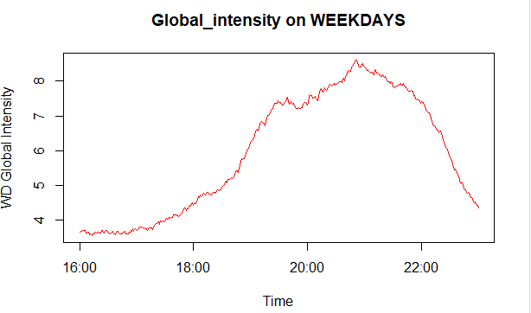
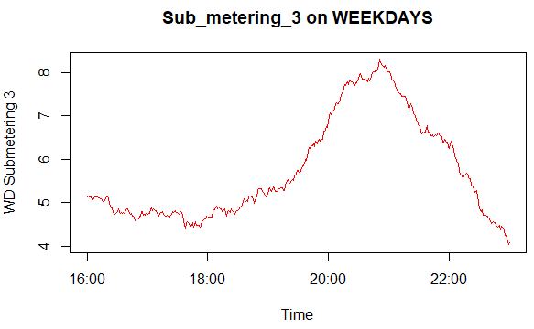
Weekdays, 4:00pm to 11:00pm

Slide 6
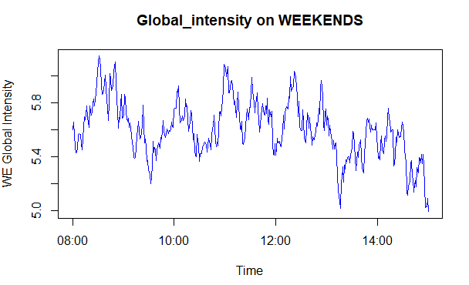
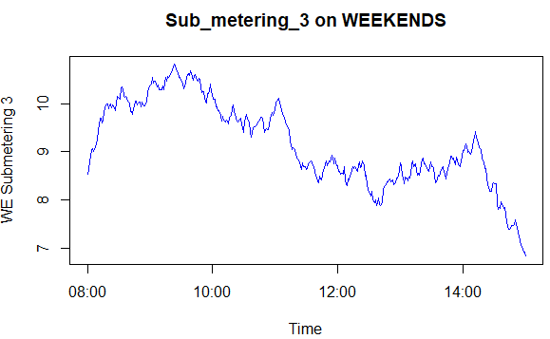
Weekends, 8:00am to 3:00pm

Slide 7
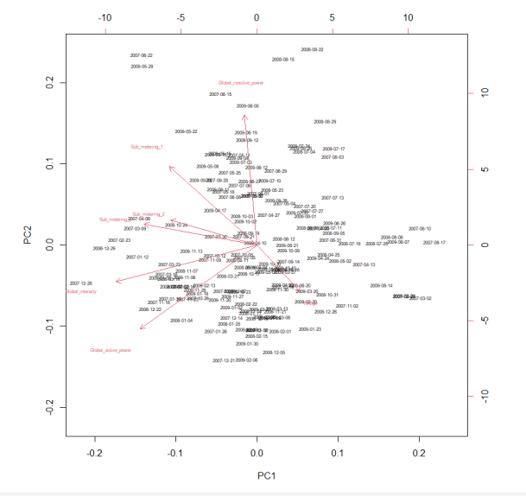
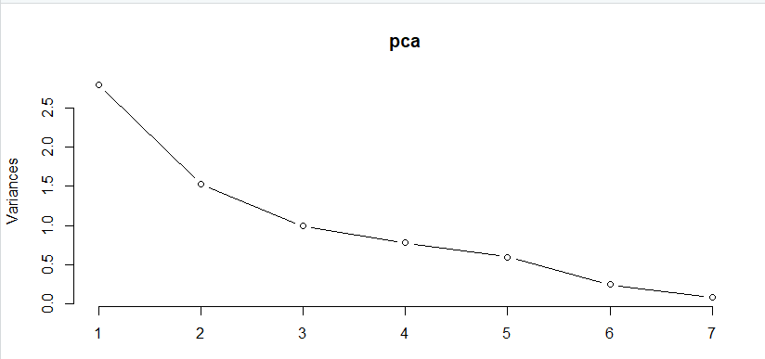
Principal Component Analysis
To find which component accounts for most variance in the dataset
Weekdays:

Slide 8
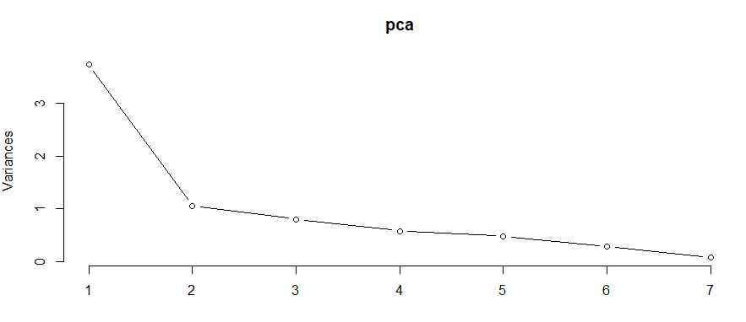
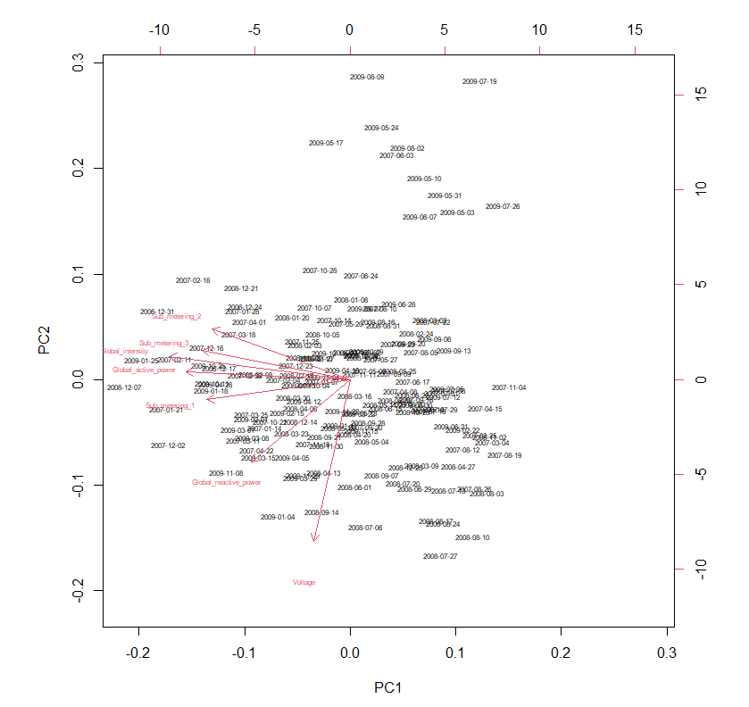
Principal Component Analysis cont.
Weekends:

Slide 9
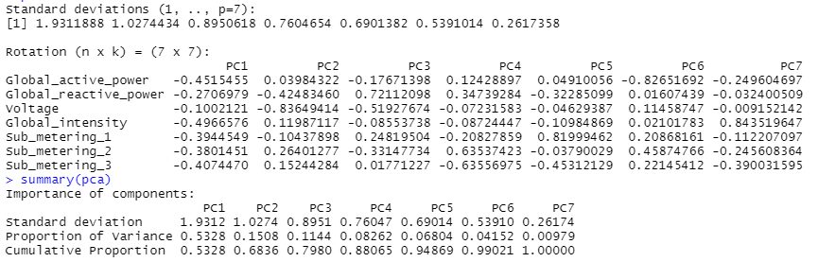
Principal Component Analysis cont.
Averaging both results:
PC1 accounted for ~45% of the total variance
next closest one PC2 with ~18%
Based off of PC1, the 3 most important variables (from most to least) were:
Global_intensity
Global_active_power
Sub_metering_3

Slide 10
Training the multivariate HMMs
To end up with a suitable probabilistic model, it must be neither overfitted nor underfitted on the data (balance the two)
Finding a sweet spot between complexity and log-likelihood
Splitting the dataset:
Train (3 years, 2006 - 2008)
Test (1 year, 2009)
Trained the models with 2, 4, 8, 12, 16, 20 states

Slide 11
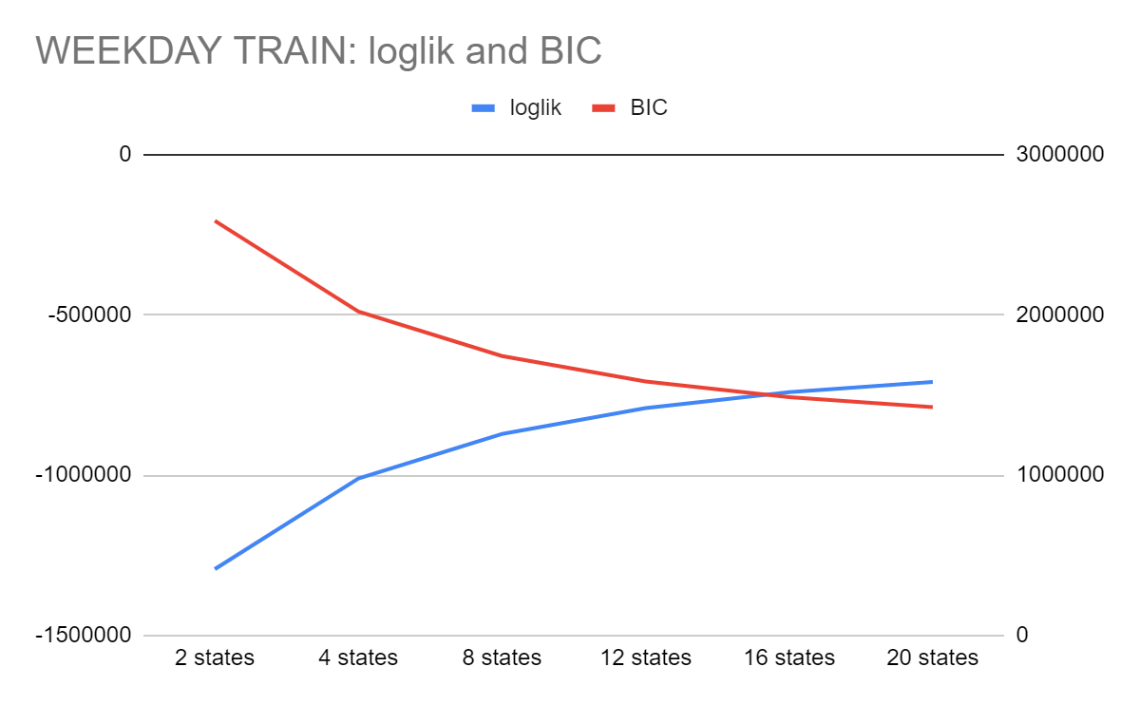
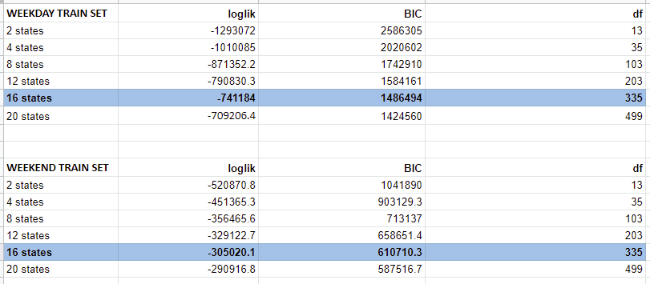
HMM Training - Weekday

Slide 12
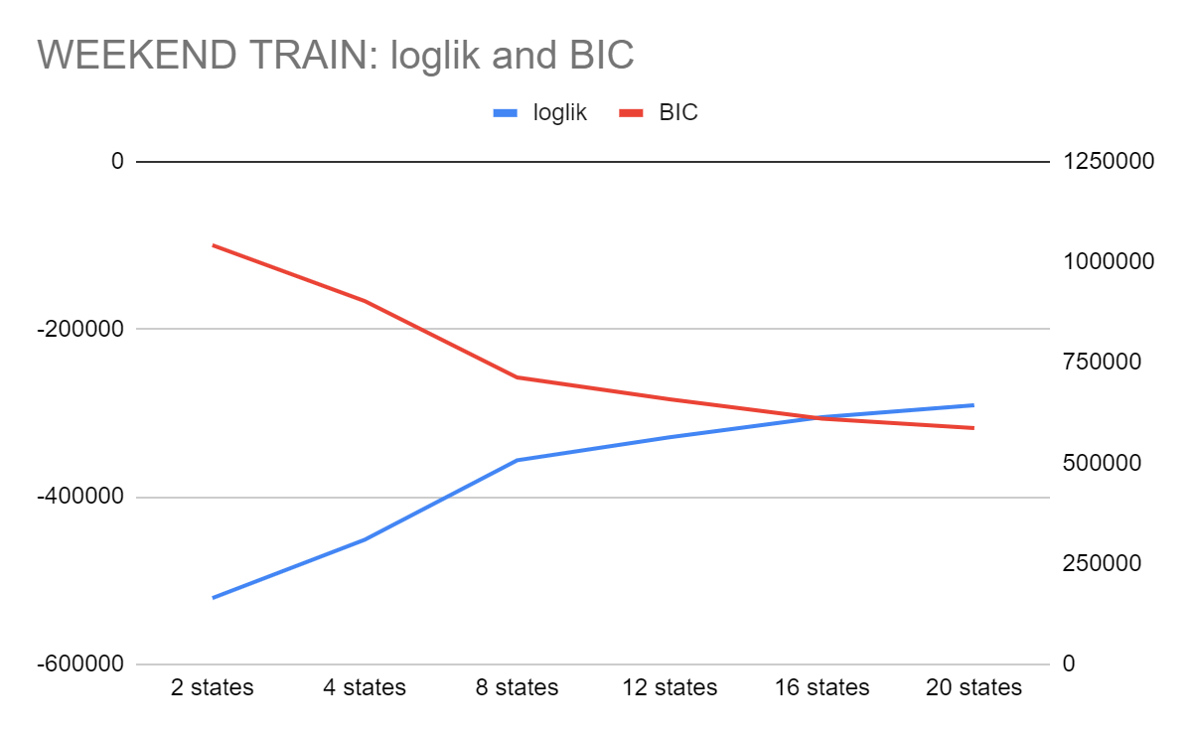
HMM Training - Weekend

Slide 13
Training the multivariate HMMs cont.
Both weekend and weekday train models found 16 states to be optimal
the log-likelihood and BIC values intersected
Does not mean that either value is ideal; models with lower BIC and higher log-likelihoods are preferred
Trade-offs need to be made

Slide 14
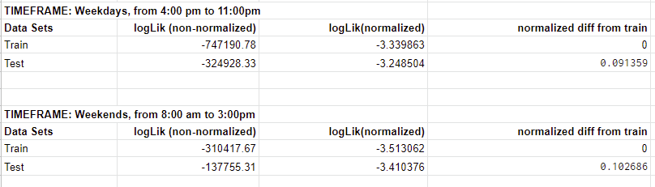
Testing the HMM
Verified the trained model by feeding our test data set and comparing the log-likelihood
Normalized the log-likelihoods before comparing, since the models cover different periods of data
Dividing the log-likelihoods by the number of rows in each dataset

Slide 15
Anomaly Detection
the trained model, now verified, could be used to detect any anomalies or patterns that deviate from the expected behavior
Log-likelihood method:
Feeding in anomaly datasets to an instance of the trained model
Calculate the difference in normalized log-likelihoods
Moving Average method:
Obtaining the moving average of the data to find any trends that are present
Calculating thresholds, which are used to detect varying levels of anomalies
We chose to do both, in order to see if one method was better than the other

Slide 16
LogLik Anomaly Detection
Subsetted the anomalous datasets to only include relevant data (our time windows)
Used the same method as verifying the model, except replacing the ‘test’ dataset with the anomalous datasets
A large difference in log-likelihood is a good indicator for detecting anomalies

Slide 17
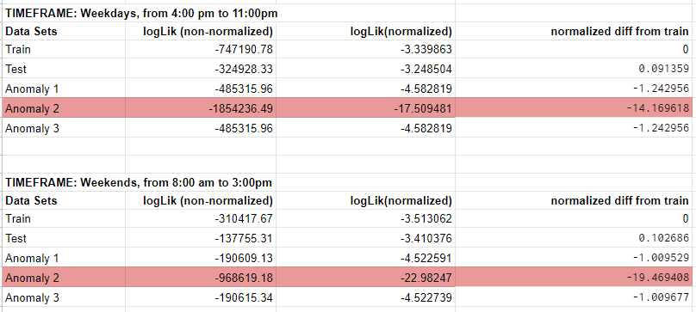
LogLik Anomaly Detection cont.
1st and 3rd datasets had the same degree of anomalies present
2nd dataset had the most anomalies by far

Slide 18
Moving Average
We also employed a moving average method to detect anomalies as that was discussed in class.
Exponential Moving Average method over a Simple Moving Average method, because it puts more weight on recent values, resulting in more accurate and representative data.

Slide 19
Moving average
We chose a window size of 10 as that provided a sufficient sample of information without intaking too much data
Thresholds of 25%, 50% and 75% of the values to determine whether the data was anomalous or not
The Moving Average function was applied to the Training dataset
Notes:
We chose these percentages since they given a roughly fair breakdown of the total values and split them into quarters which allow us to see the effects of various thresholds. The Moving Average function was applied to the Training dataset to get an idea of what kind and how many anomalies were we working with and to give us a base to compare the results of others to. We were then able to count the number of anomalies in each dataset, resulting in this data:

Slide 20
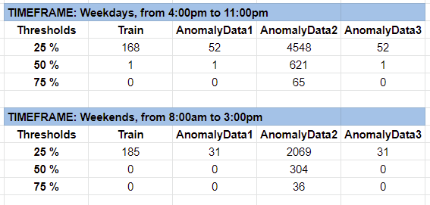
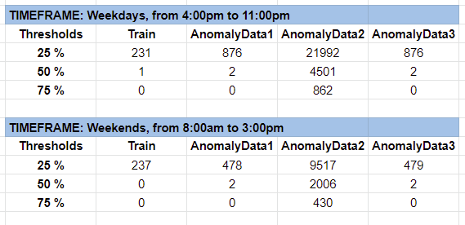

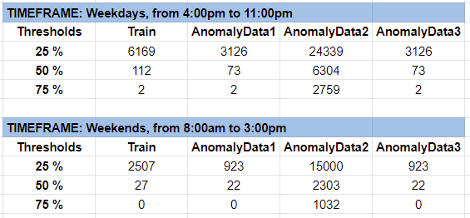
Global Active Power
Global Intensity
Insert moving average graphs here
SubMetering_3

Slide 21
Strong correlation between Moving Average and log-likelihood
Anomaly datasets 1 and 3 having the same proportion of anomalies, with dataset 2 containing drastically more anomalies
Looser the threshold, higher the number of detected anomalies
25% might be too strict, as it may mistake completely normal data points to be anomalies. 75% may not be strict enough and miss some anomalies. The threshold should ideally be a middle point of the two, and from the results it seems that 50% is a good candidate.

Slide 22
Mean-Standard Deviation method
Verify the findings of Moving Average and log-likelihood
Mean and Standard deviation method
Respective values of the datasets(including the anomalous ones) and found a ‘min’ and ‘max’ values based on the formula for those two boundaries as:-
Min = mean(data) - n*sd(data)
Max = mean(data) + n*sd(data)

Slide 23
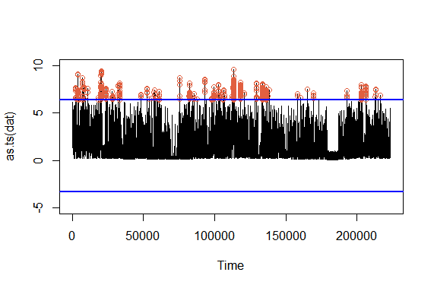
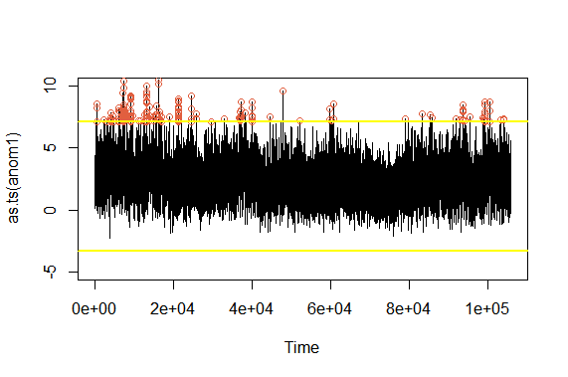
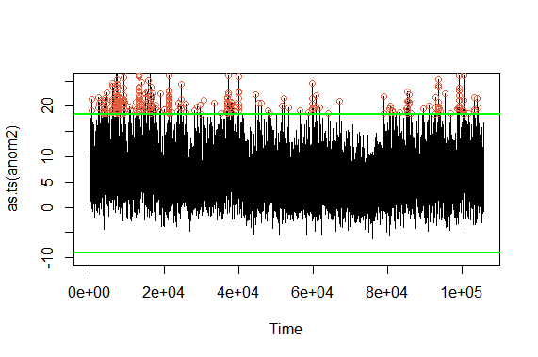
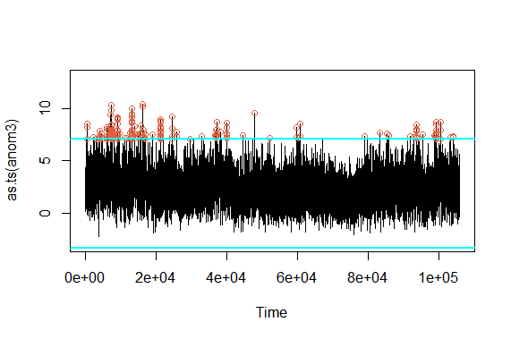
Global Active Power(Weekdays)

Slide 24
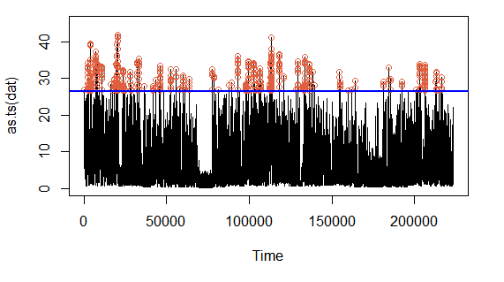
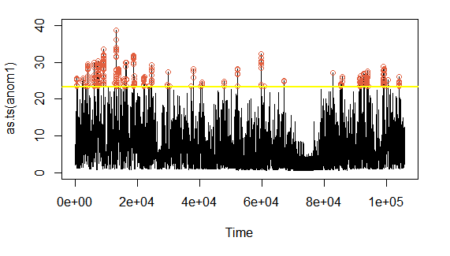
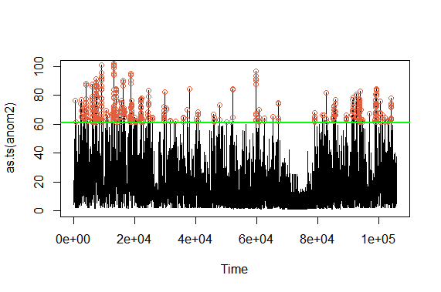
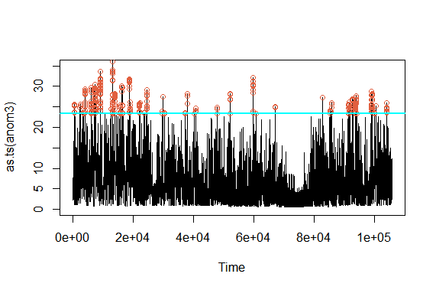
Global Intensity(Weekdays)

Slide 25
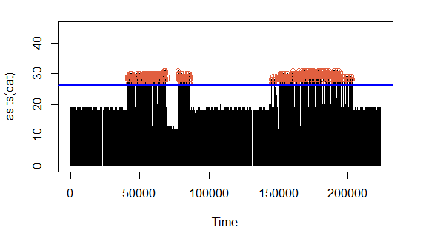
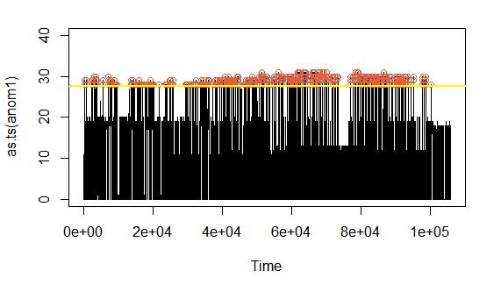
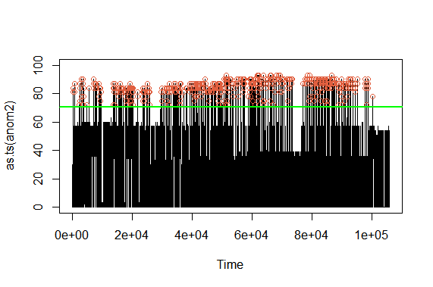
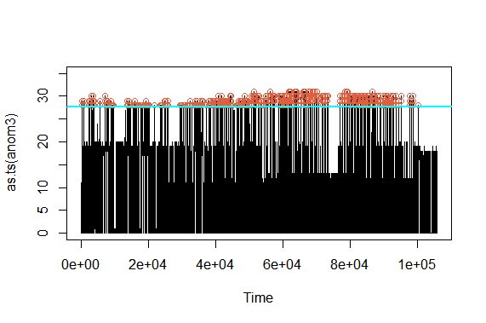
Submetering_3(Weekdays)

Slide 26
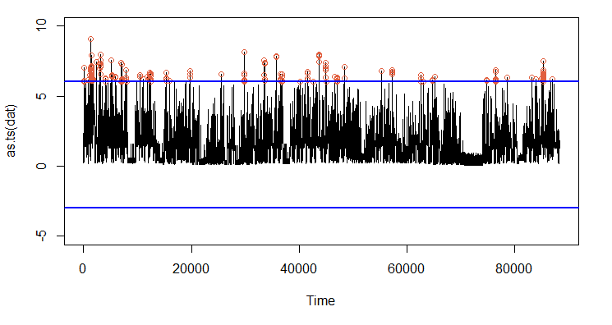
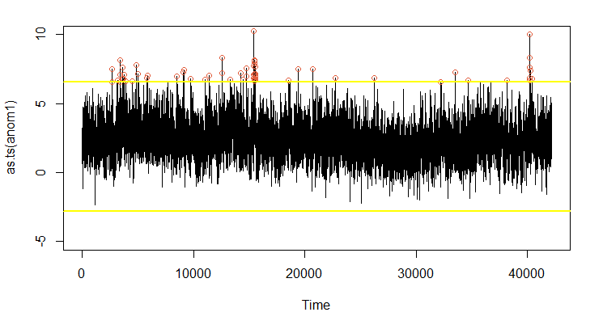
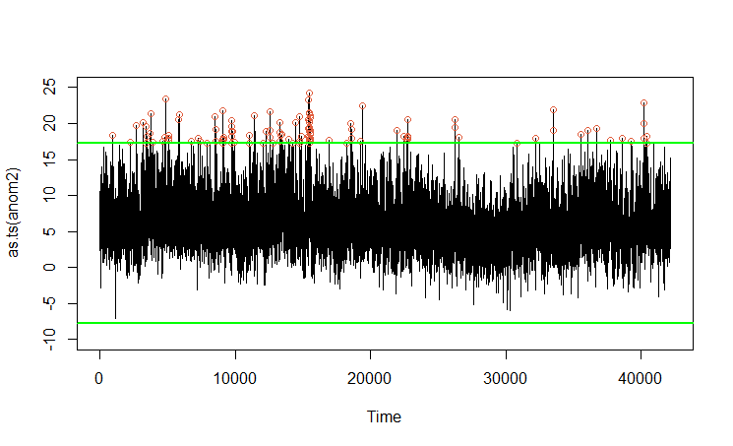
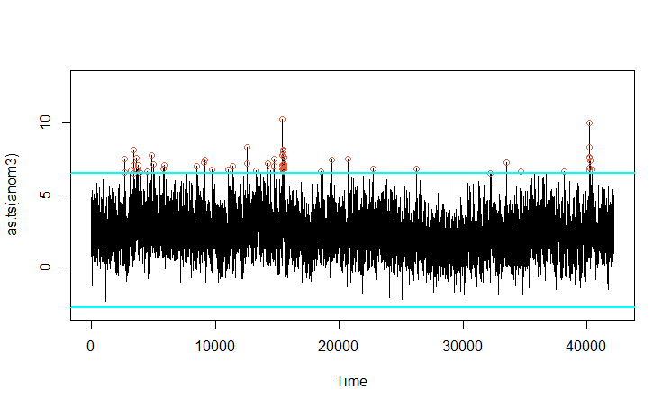
Global Active Power(Weekends)

Slide 27
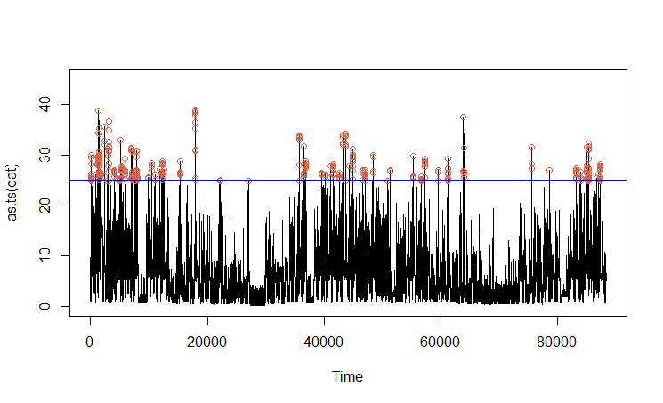
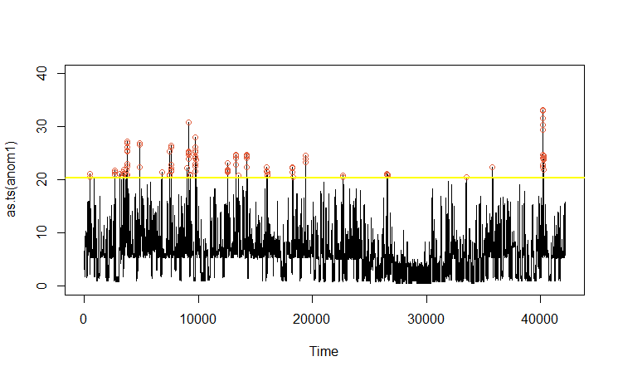
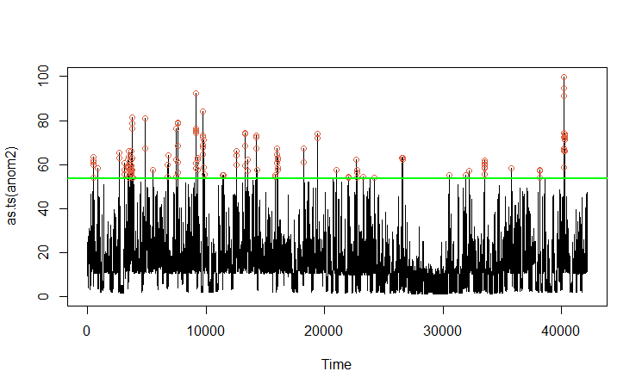
Global Intensity(Weekends)

Slide 28
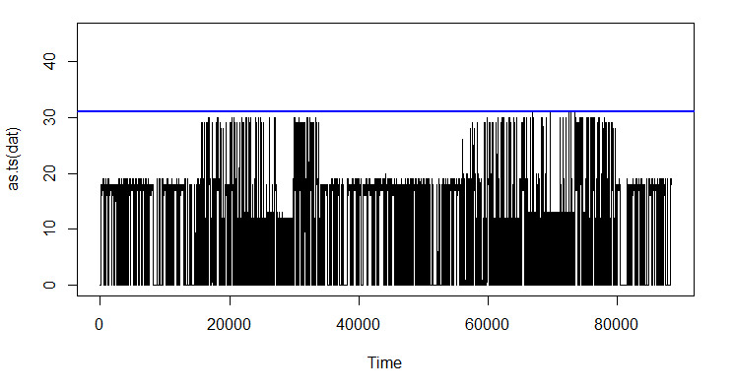
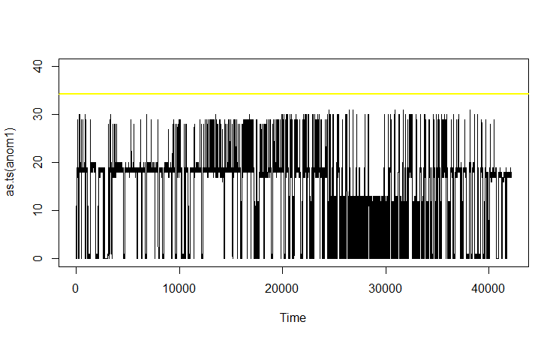
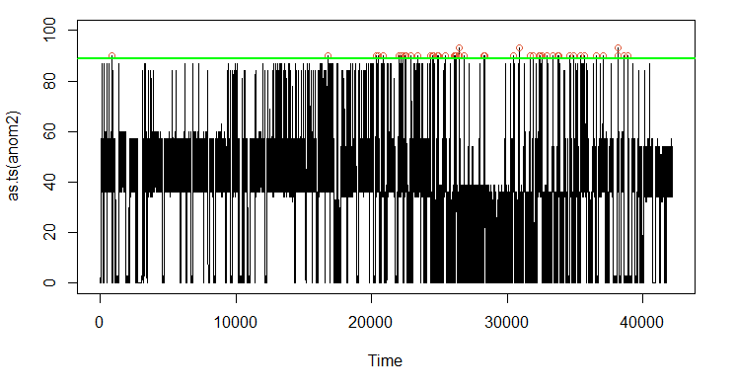
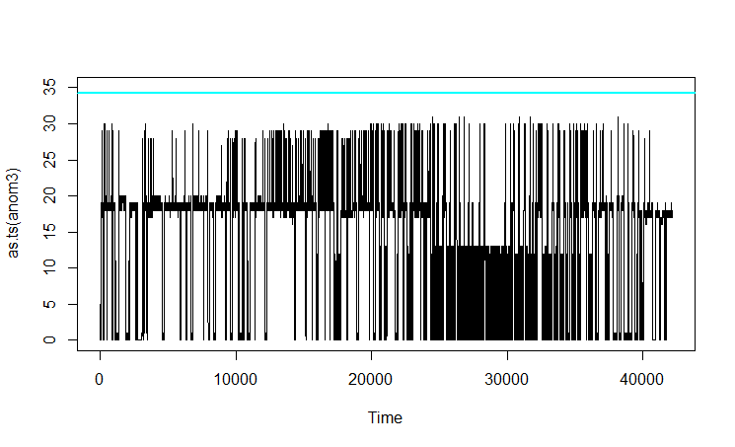
Submetering_3(Weekends)

Slide 29
Problems we encountered
Firstly, dealing with N/A values proved to be quite cumbersome and caused us a few problems initially.
Similarly, we had to deal with many 0 values when working with variables such as Submetering, which also caused issues with the data analysis and anomaly detection.
The PCA biplots did not appear very appealing due to the large amount of data points, which was unfortunate.
Additionally, running the code requires a significant time investment and decent CPU power as it requires training a 16 state HMM.

Slide 30

Reinforcement Learning - What is it?
Unique and powerful approach towards Machine Learning
An agent, namely an artificial intelligence program, performs actions in its environment which results in changes in the environment’s state.
Depending on the state that is reached, the agent may receive a reward or a punishment. EX: an increase or decrease in its overall score.

Slide 31
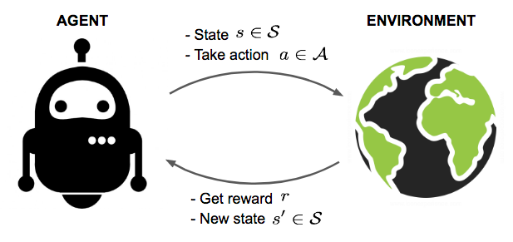
Reinforcement Learning - How does it work?
Learning can be achieved through a brute force approach, in which the agent will perform random sequences of actions
Over many iterations and an extended duration, the agent can learn which sequences of actions result in rewards and “learns” how to complete the task.
Agent grows smarter and more optimized as time passes, until its progress ultimately plateaus and the agent reaches an optimal policy.

Slide 32

Reinforcement Learning - How does it work?
As with other methods of machine learning, this type of approach is enabled by the fact that many iterations and actions can be taken in parallel, due to the agent’s actions being done virtually.
Unlike a human agent, an artificial intelligence agent is much less bounded by time, as it can easily perform thousands of actions per second in different scenarios, thus being able to “brute force” the correct sequence of actions through sheer probability.

Slide 33
Reinforcement Learning - Advantages
Compared with supervised learning, reinforcement learning can yield more efficient and creative solutions.
This is because an AI does not have the same limitations as a human, and thus may be able to complete the given task in a novel and unique way that a human may not have been able to derive.

Slide 34

Reinforcement Learning - Example
An example of this advantage can be seen in artificial intelligence that has been trained to complete specific video games.
Since these agents run in a virtual environment, they can exploit certain elements of game interaction that may lead to more efficient solutions, such as inputting multiple movements at once and performing actions that ignore the need for reaction time, both of which are human limitations that do not apply to the AI.

Slide 35
Reinforcement Learning - Advantages
This enables reinforcement learning to be able to achieve highly efficient and optimized solutions, sometimes even for highly complicated problems.
It is also less susceptible to repeating errors in its action sequence

Slide 36
Reinforcement Learning - Disadvantages
However, that isn’t to say that reinforcement learning does not come with certain disadvantages.
Reinforcement learning requires a large amount of data to work with in order to provide optimal results, which means it is not a good choice for solving simpler problems.
Due to this high data requirement, significant computation power is also needed to reduce the time needed to work with the sheer amount of data the agent makes use of.

Slide 37
Reinforcement Learning - Disadvantages
Another common problem that may arise is a behavioural overfit to a sequence of actions in order to maximize rewards.
This can occur when the states in which the agent receives a reward are not well designed, resulting in the agent’s actions generating a high amount of rewards without actually completing the intended task.
This issue is known as the “alignment problem.”

Slide 38
Reinforcement Learning - Disadvantages
Additionally, having too few reward states may result in the agent never finding an optimal solution to the problem.
If the correct sequence of actions before a reward is highly complicated and specific, results in the agent taking far too long or not finding a solution at all, even through many iterations of random actions.
This can be especially true when there are a large amount of possible actions an agent can perform, for example, a robotic arm has many different possible moves, having multiple parts and appendages to maneuver in 3 dimensions. For this reason it may not be feasible to train a robotic arm to perform a complicated action with reinforcement learning.

Slide 39
AI Cyber Attacks - Background
As time passes, it is inevitable that humanity will continue to make progress in developing technology with ever increasing complexity and functionality.
As such, cyber security attack methods will also become increasingly capable and dangerous. The upsurge of sophistication of these attacks can pose serious threats to individual and even national security, which warrants the need of improving current cyber security measures.
One possible new cyber attack method that could be imposed in the near future are attacks carried out by an artificial intelligence.

Slide 40

AI Cyber Attacks - A New Threat
This type of attack may be troublesome to defend against with our current security measures, as AI driven behaviour can be a black box, without any way to predict or anticipate its behaviour.
This makes it difficult for humans to design defense measures against such an attack, as the malicious AI could be much more cunning than any human attackers that have been dealt with in the past.

Slide 41
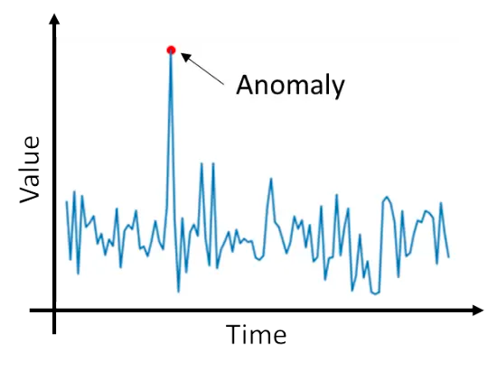
Anomaly Detection Systems - Introduction
Can be used to identify when an online system has had its security compromised, which allows for appropriate countermeasures to be taken in a timely manner.
Gathers information about standard user behavior and determine expected or “normal” patterns of behavior. This is useful in recognizing when irregular (and possibly harmful) actions are being taken.

Slide 42
Anomaly Detection Systems - Drawbacks
General anomaly detection systems that do not utilize AI can be effective at doing this, but carry several drawbacks.
There can be a large proportion of warnings/intrusion alarms that are raised without any real threat. This is because while a standard intrusion detection system may be able to find deviations in standard or expected user behaviour, it may not be ill-intentioned behavior that it flags as dangerous, resulting in a significant possibility for false alarms.

Slide 43
Anomaly Detection Systems - Drawbacks
Systems that do not suffer from a high rate of false alarms do exist, but do so at the tradeoff of not being able to recognize unique and unseen types of attacks, which nullifies much of its usefulness in the wake of AI cyber attacks.
Creating systems that solve both of these issues results in a system that is overly complex and difficult to implement in a variety of environments.
Requires a large degree of case specific parameters to be set, resulting in a solution that is not adaptable nor scalable.

Slide 44
Using AI for Cyber Security
One possible countermeasure for the looming threat of AI cyber attacks is using AI to protect us from AI.
Anomaly Detection systems powered by artificial intelligence can provide a greater degree of defense and attention to detail compared to existing methods
Reinforcement learning presents itself as a highly viable method for developing proficient enough AI to protect ourselves.
If designed correctly, can avoid many problems that current systems have today.

Slide 45
Anomaly Detection Systems through Reinforcement Learning
These AI systems suffer less from high false alarm rates, while also maintaining itself as an adaptable security measure, being able to detect varying signs of intrusion and possibly even being able to infer whether simple behavioral anomalies are innocent or malevolent.
May even be able to provide us with ample protection in the case of a never before seen cyber attack being put in place, as its policy is not shaped by an example, but rather, its experiences.

Slide 46
Anomaly Detection Research - Promising Results
For example, researchers at the University of York employed a method of reinforcement learning with the addition of “tile coding” to create an agent capable of detecting possible DDoS attacks by examining incoming network traffic information and patterns.
Their agent was first trained with real-life data and was able to find anomalous data and behaviour and act accordingly.
While they succeeded in creating a viable agent which solved many problems that current detection systems suffer from, it did not come without its own drawbacks.

Slide 47
Anomaly Detection Research - Shortcomings
Their agent struggled at times dealing with highly complicated attacks, and in such cases could raise false alarms.
Despite this however, the researchers were optimistic that their agent could be further refined in various ways to both add functionality and lessen its shortcomings.

Slide 48
Reinforcement Learning - Summary
Reinforcement learning is an effective and advantageous approach for developing and teaching proficient AI.
In the face of the possibility of artificial intelligence fueled cyber attacks, applying reinforcement learning to develop anomaly detection systems is a promising cybersecurity measure.
While it is not without its flaws, it can be much more powerful than other conventional methods due to its ability to detect complex and unique attacks in ways that humans could not implement otherwise.

Slide 49

Reinforcement Learning - Final Remarks
Ultimately, it is not the goal of cybersecurity to be able to block every possible cyber attack, but rather have an optimal method in place to allow for damage reduction, and artificial intelligence presents itself as a quite capable solution for achieving that goal.
Cybersecurity researchers are continuing to push the boundary of AI systems and their capabilities, and it is becoming increasingly clear that reinforcement learning and artificial intelligence as a whole will become a valuable tool to add to humanity’s arsenal of cyber security measures in the near future.

Slide 50
Conclusion
We learnt a lot about anomaly detection based intrusion detection methods.
Difficulties in anomaly detection
N/A values, 0 values with Submetering(data analysis and anomaly detection issues)
PCA biplots did not appear very appealing due to multiple data points
Running time issues for states greater than 12
Technical essay showcased how AI enables more complex and powerful intrusion detection systems
Notes:
We learned about the various tools needed to ensure that we properly conducted anomaly detection, which is very important and credible data is what one seeks when doing this type of analysis. dealing with N/A values proved to be quite cumbersome and caused us a few problems initially.

